Slide 1

STORAGE AND ORGANIZATION OF LARGE GEOSPATIAL DATASETS ON A DISTRIBUTED BLOCKCHAIN
Shivanshu Singh | Ayush Tah

Slide 2

Ever-growing geospatial data requires secure and scalable storage for archiving data. Block chain-based technologies can offer strong byzantine fault tolerance and distributed data storage and access. However currently there are no mature options for storing and organizing large geospatial datasets on a distributed blockchain.
PROBLEM STATEMENT

Slide 3
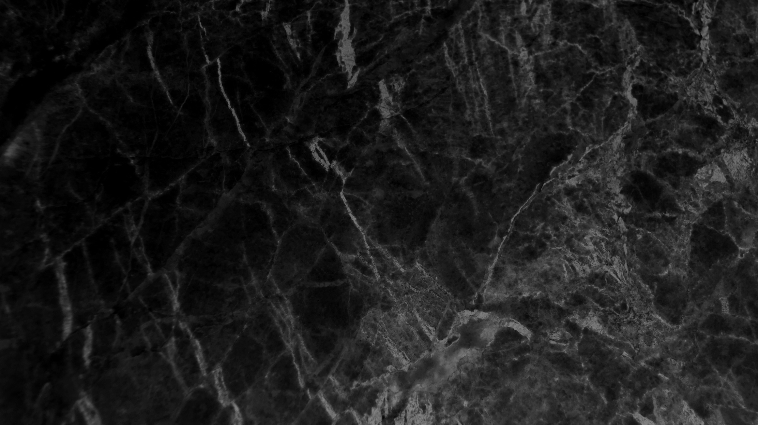
Geospatial data is information that describes objects, events or other features with a location on or near the surface of the earth. It combines location information and attribute information with temporal information.
In layman's terms, Geospatial Data Contains the data associated with places on earth. It consists primarily of 2 data models, vector(longitude, latitude etc) and raster data(temperatures, land type etc).
WHAT IS GEOSPATIAL DATA?

Slide 4

It is estimated that 100 TB of weather-related data is generated daily. This alone presents considerable storage and access problems for most organizations.
Geospatial data typically involves large sets of spatial data gathered from many diverse sources in varying formats and can include variety of information.
Since information from geospatial data are very useful, we need to figure out a way of how to store and organize large datasets, so that it can be easily accessed.
WHY STORING AND ORGANIZING LARGE GEOSPATIAL DATASET IS IMPORTANT?

Slide 5
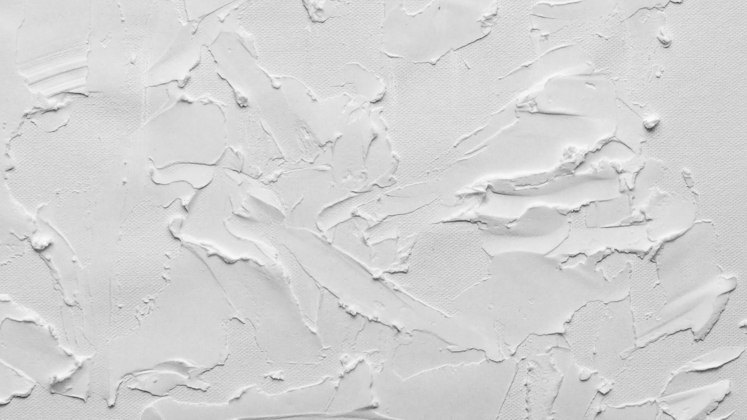
Some file formats associated with geospatial data:
shapefiles (.ship)
geodatabase (.gdb)
keyhole markup language (.kml or .kmz)
GeoTIFF (.tiff)
comma-separated values (.csv)
GeoJSON (.json)
GPS Exchange Format (.gpx)
LiDAR point cloud data (.las)
WHAT ARE THE FILES ASSOCIATED WITH SAID DATA?

Slide 6

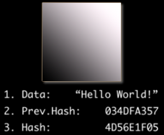
WHAT IS A BLOCKCHAIN?
A blockchain is type of distributed ledger technology (DLT) that has a continuously growing list of records, called blocks, which are linked and secured using cryptography.

Slide 7

Blockchain is considered one of the promising solutions because of the following characteristics it posses:
Immutable
Safer
Resilient
Cheaper
Transperancy and Accountability
Control
Trustless
Smart Contracts
WHY BLOCKCHAIN?

Slide 8
InterPlanetary File System or IPFS for short, is a protocol, hypermedia and file sharing peer-to-peer network for storing and sharing data in a distributed file system. IPFS uses content-addressing to uniquely identify each file in a global namespace connecting IPFS hosts
WHAT IS IPFS?

Slide 9

We are trying to combine the above mentioned technologies to revolutionize the way we store geospatial data. With the help of blockchain and IPFS we can store the geospatial data in a blockchain network which will provide all the benefits that blockchain provides, though the retrieval and storage of data will be slower that conventional mass storage but as this is more for archival of data rather than regular use this is a possible solution.
HOW ARE WE TRYING TO TACKLE THE PROBLEM?

Slide 10
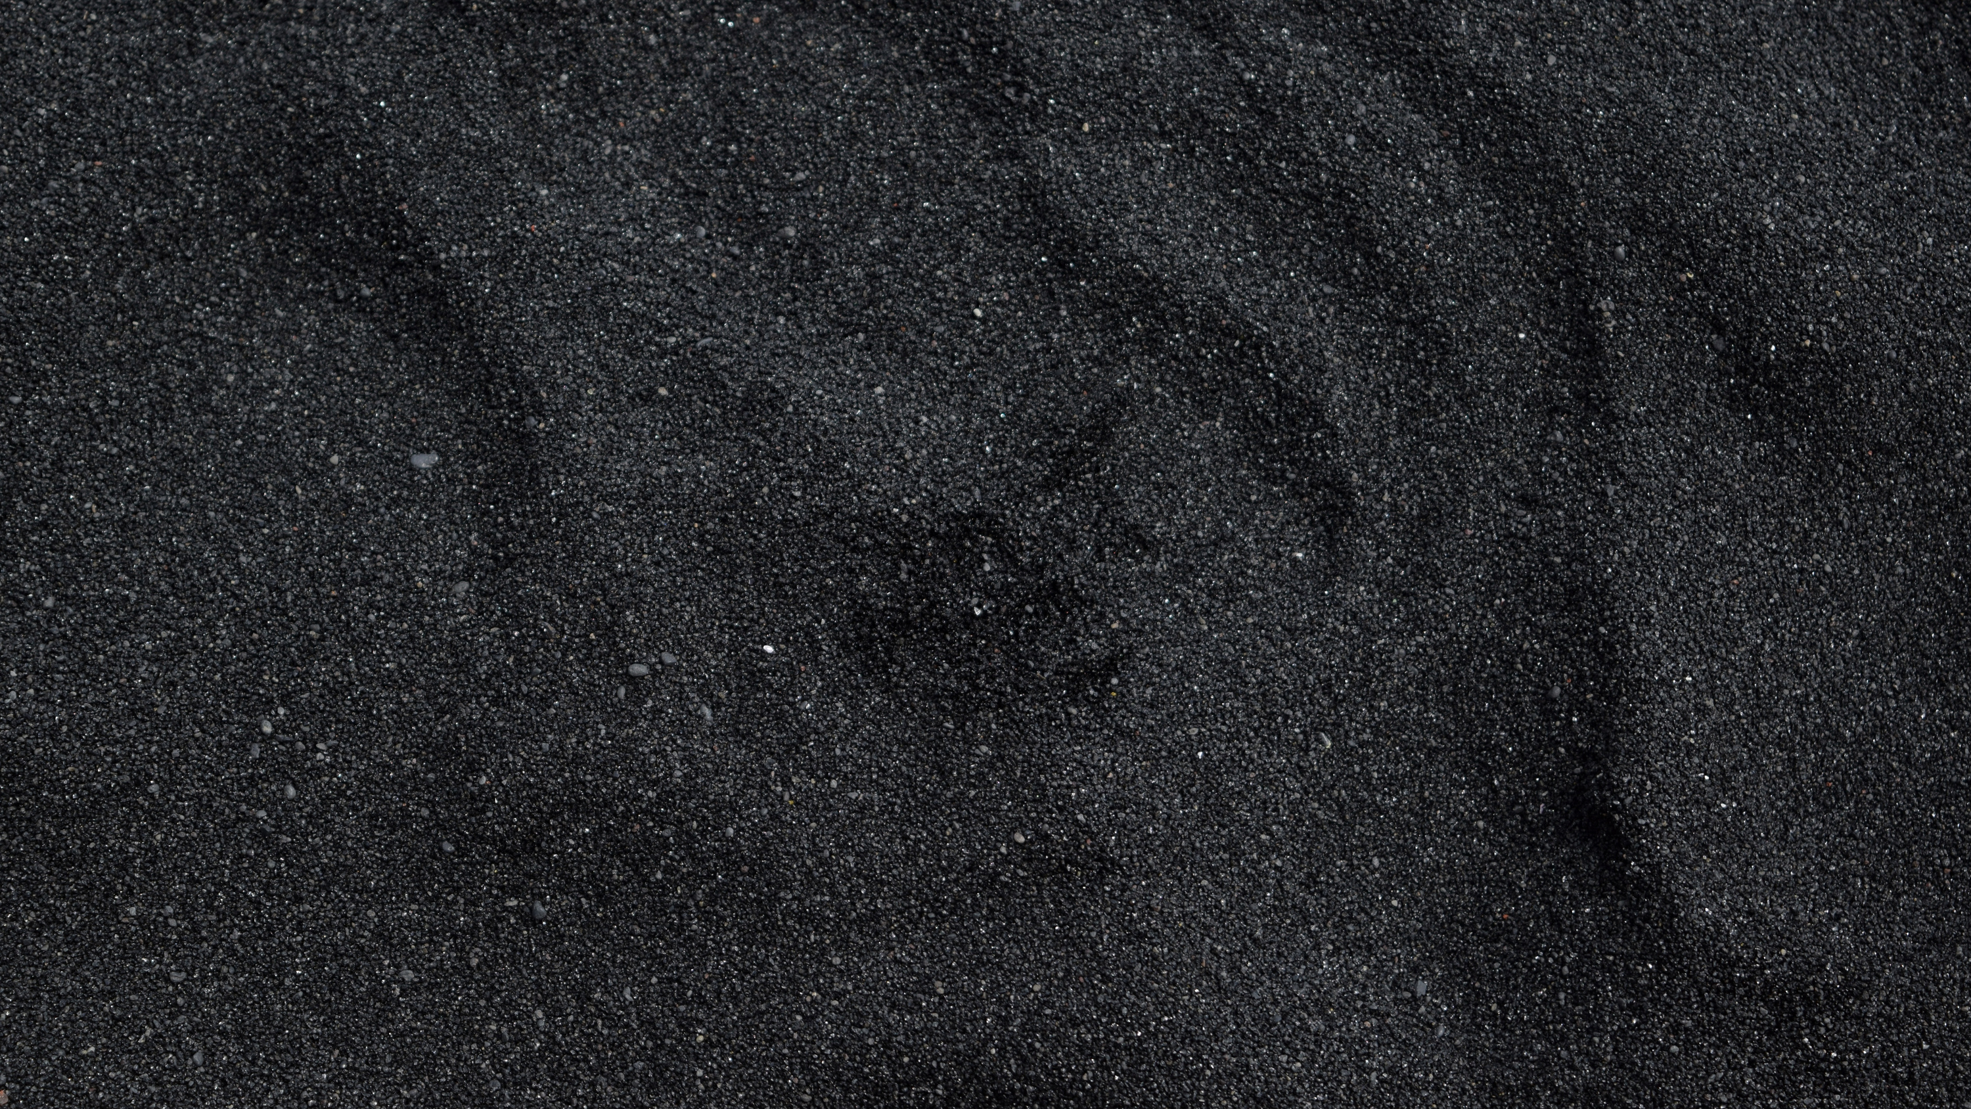
Now , the problem stated is listed in SIH and a sample data set is also provided which only contains .tiff files and they are large size high quality images. So we are first trying to implement the system and optimize it for the .tiff file format and experiment how it plays with it and upon receiving satisfactory result we would like to move to different formats.
We will also try to work on a GUI interface or a web app with which the user can easily interact with the system and use it efficiently.

